Slide 1


Air Quality Database Management System
GROUP -07
AIR
QUALITY IN INDIAN CITIES
NANDINI BHUVA - 19BIT085
NIDHAY PANCHOLI - 19BIT087
SHAMBHAVI KUMAR - 19BIT115
VIVEK DEVRE - 19BIT131
NIDHI ZALA - 19BIT088

Slide 2

ABSTRACT
INTRODUCTION & HOW OUR SYSTEM TACKLES THE PERSISTING PROBLEM
There are growing concerns about the Air quality all over the world but in case of India the concerns rise even more as not enough data collection takes place from various locations.
This system tries to overcome that problem by effective collection of data and a rating system similar to the ‘Relative Strength Index’ used commonly in the stock market to identify trends .
The identification of the trend will help in comparing data from all station on the same level in spite of the Air quality from two places being in different ranges.

Slide 3
CURRENT SYSTEM VS OUR SYSTEM
Flaws in the current system:
India has just 0.14 station/million person [1] and 216 in total.
The data for not all pollutants is collected across all stations.
No utilization of the correlated data of renewable energy and petroleum products.
Our System tries to improve upon this by
Creating a rating-based system for all available stations to identify the increasing trend of pollution early.
Data about the available renewable resources is included to identify states with higher renewable resource potential but underutilization of the same.
Data about the consumption of petroleum-based products is collected to identify the states with higher consumption and if possible, replace these products with eco-friendly products.

Slide 4

How the Rating system works?
Our system works on the following steps for calculating the rating of any particular day,
Gets the data of the past n number of days.
Calculates the ratio of change in concentration of pollutant.
Calculates the average of all the increases and average of all the decreases.
The rating is calculated using the formula,
Rating= 100 - 100/(1+(Average Increase/Average Decrease))

Slide 5
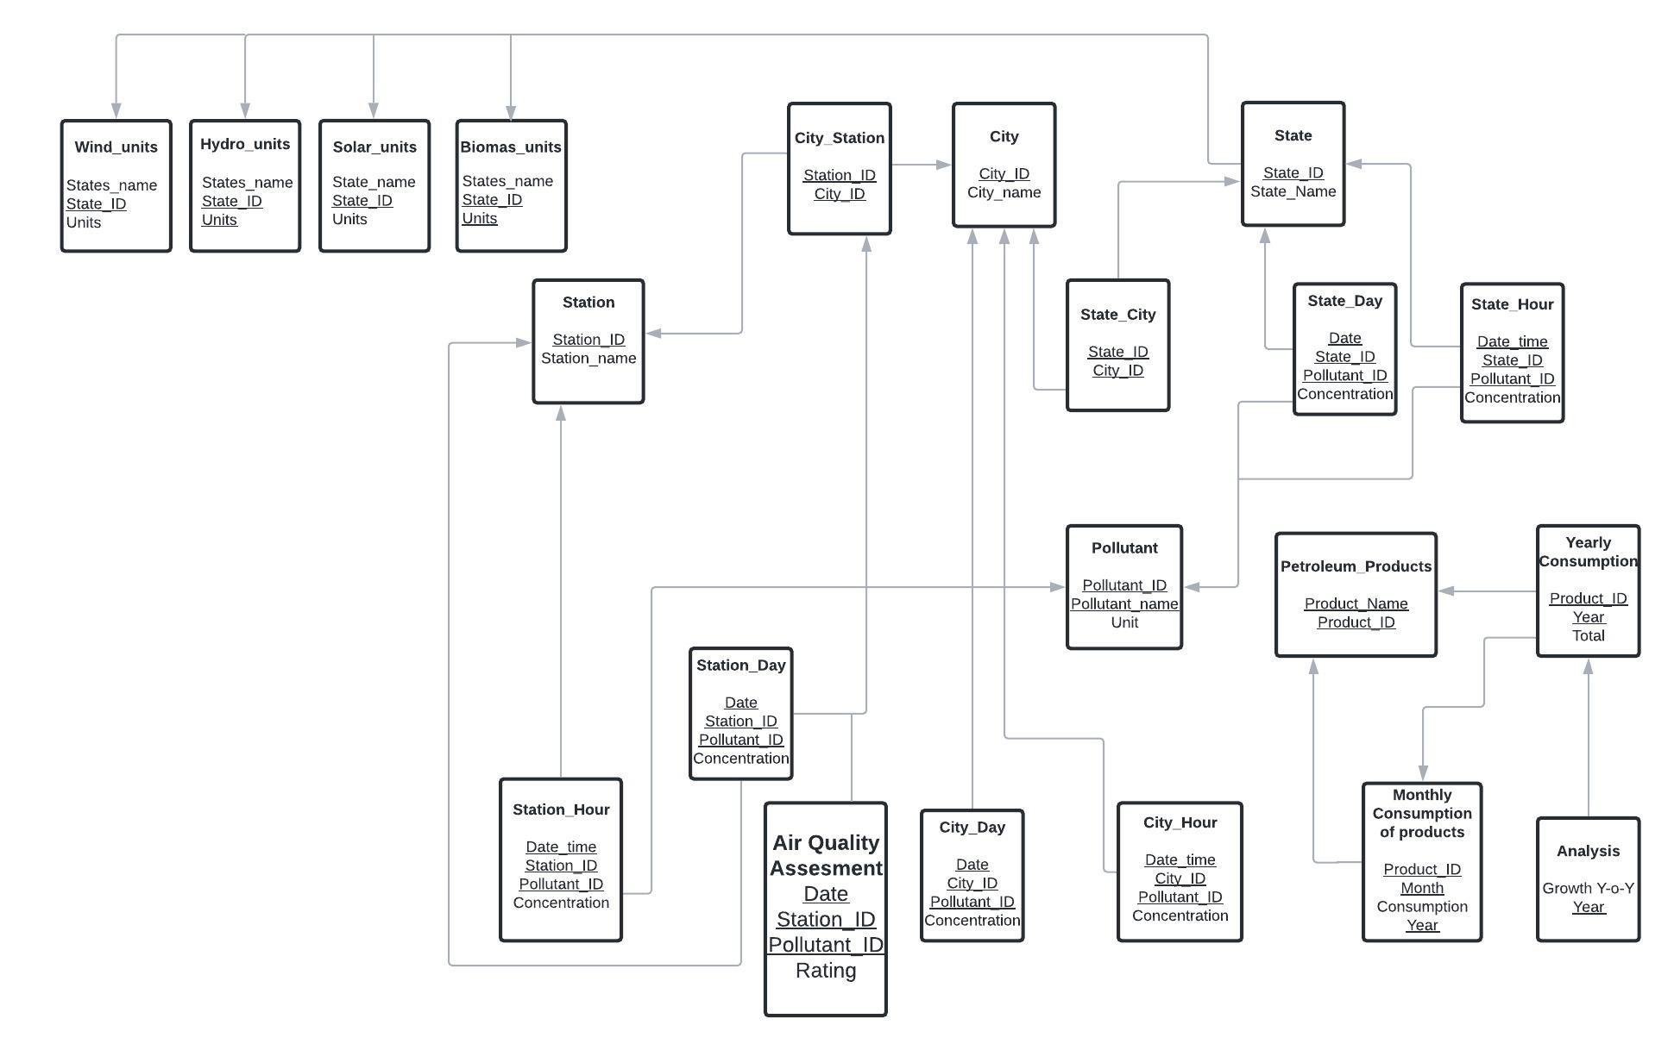
The Relational Model

Slide 6

EXPERIMENTAL ANALYSIS
FEATURES IN OUR RESEARCH | OUR RESEARCH | RESEARCH PAPER/ LITERATURE-REVIEW/ ARTICLE/ BOOK-1 | RESEARCH PAPER/ LITERATURE-REVIEW/ ARTICLE/ BOOK-2 | RESEARCH PAPER/ LITERATURE-REVIEW/ ARTICLE/ BOOK-3 | RESEARCH PAPER/ LITERATURE-REVIEW/ ARTICLE/ BOOK-4 | RESEARCH PAPER/ LITERATURE-REVIEW/ ARTICLE/ BOOK-5
Filtering data of pollutants to only analyze the most influential data. | YES | NO | YES | NO | YES | YES
Data is being collected using optical sensors. | YES | YES | YES | YES | YES | YES
Dashboard to visualize concentration of various pollutants at one glance. | YES | NO | NO | NO | NO | NO
Information about petroleum product usage is used to correlate with air pollution | YES | NO | NO | NO | NO | NO
Data of the potential renewable energy reserves is included to signify the future decrease in Air pollution because of increase in renewable energy usage. | YES | NO | NO | NO | NO | NO

